Slide 1


A swarm of robots for encouraging desired social behaviors
Serge Saaybi
Thesis Status update report
TU Delft | 20 April 2021

Slide 2
Work done this week
A swarm of robots for encouraging desired social behaviors
I tried to run different simulations:
Unity
Deploying DRL algorithms in a unity environment using ML agents
ROS and Gazebo
Deploying OpenAI-gym and Stable Baselines algorithms in a Gazebo environment while using ROS

Slide 3
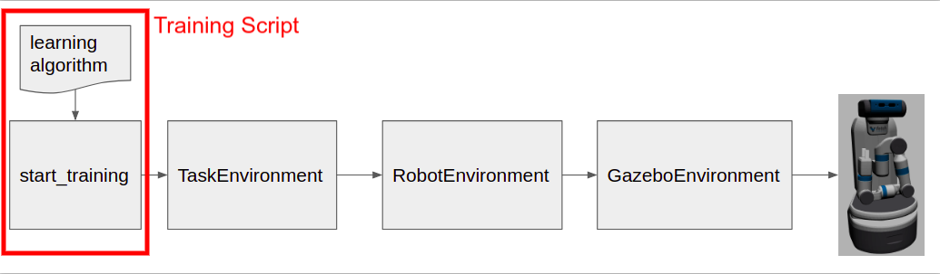
openai_ros
OpenAI Reinforcement Learning infrastructure to train ROS based robots in Gazebo simulations
The openai_ros package:
It contains the GazeboEnvironment class that connects the OpenAI programs to Gazebo.
It provides a group of already made RobotEnvironments for the most popular ROS based robots. It provides an integration between the Gazebo simulation of the robot and the OpenAI algorithm environments for obtaining sensor information from the robot or sending actions to it
It provides a group of already made TaskEnvironments that you can use together with the RobotEnvironments and GazeboEnvironment to train a robot in the task defined in the TaskEnvironment.

Slide 4
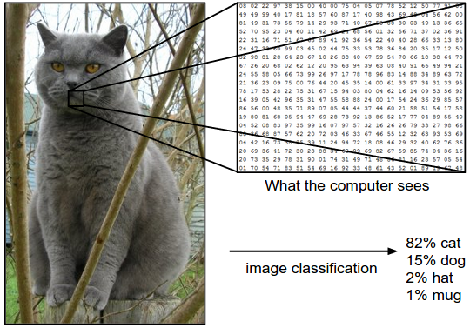
Image classification
Algorithms:
Data-driven approach:
Nearest Neighbor Classifier: Given a series of images to label, the nearest neighbor classifier will take a test image, compare it to every single one of the training images, and predict the label of the closest training image
k - Nearest Neighbor Classifier: instead of finding the single closest image in the training set, we will find the top k closest images, and have them vote on the label of the test image
Linear Classification: Consists of a score function (maps the raw data to class scores) and a loss function (quantifies the agreement between the predicted scores and the ground truth labels). This then becomes an optimization problem in which we will minimize the loss function with respect to the parameters of the score function
Considering that there are three color channels Red,Green,Blue, we then have 248 x 400 x 3 numbers = 297,600.
Each number is an integer from 0 (black) to 255 (white)

Slide 5
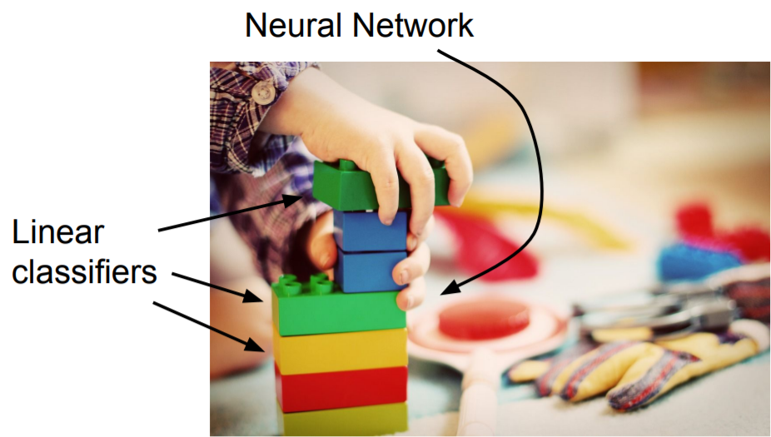
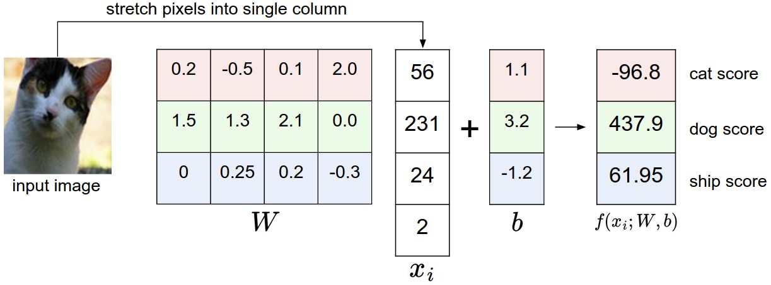
Image classification
Linear Classification- General
Linear Classification are the first step towards forming neural networks
We assume the image only has 4 pixels. The parameters in W are called the weights, and b is called the bias vector

Slide 6
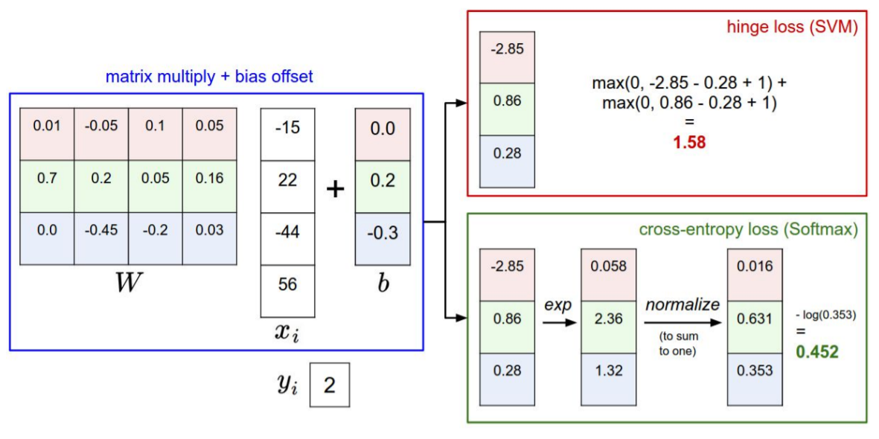
Image classification
Linear Classification- General
SVM classifier and loss:
Multiclass Support Vector Machine loss: The SVM loss is set up so that the SVM “wants” the correct class for each image to a have a score higher than the incorrect classes by some fixed margin Δ.
Softmax classifier and loss:
The Softmax classifier gives an intuitive output (normalized class probabilities).
Regularization
We add a regularization penalty R(W) such as the L2 norm, that discourages large weights. The penalty is a function of the weights only. penalizing large weights tends to improve generalization, as no input dimension can have a very large influence on the scores all by itself.

Slide 7
Optimization of the loss
The loss function lets us quantify the quality of any particular set of weights W. The goal of optimization is to find W that minimizes the loss function.
Strategy #1: Random search: try out many different random weights and keep track of what works best
Strategy #2: Random Local Search: Start out with a random W, generate random perturbations δW to it and if the loss at the perturbed W+δW is lower, perform an update.
Strategy #3: Following the Gradient: Instead of choosing randomly, compute the best direction along which to change the weight vector.There are two ways to compute the gradient: A slow, approximate but easy way (numerical gradient), and a fast, exact but more error-prone way that requires calculus (analytic gradient).
Optimization via Gradient Descent:
Loop:
Sample a batch of data.
Compute the scores and the loss.
Backprop to calculate the gradients.
Update the parameters using the gradients.

Slide 8
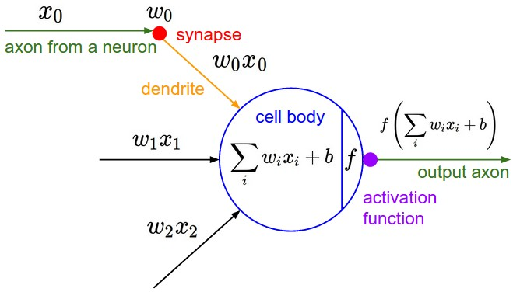
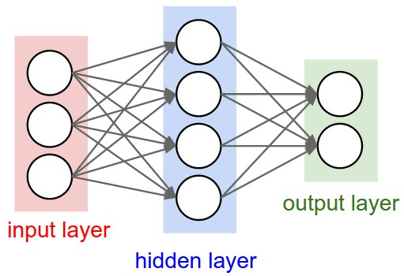
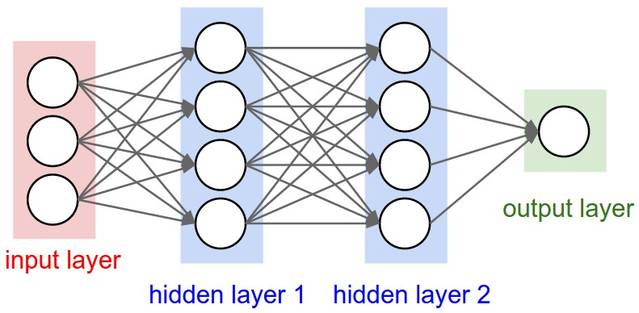
Neural networks
(Before) Linear score function: f = Wx
(Now) 2-layer neural network: f = W2*max(0,W1*x)
Where max is the RELU non-linear function
(Now) 3-layer neural network: f = W3*max(0,W2*max(0,W1*x)
What is a Neuron:
An artificial neuron which computes a weighted sum of its inputs then applies an activation function
What is a Neural Network: Neural Networks are modeled as collections of neurons that are connected in an acyclic graph. A network may have three types of layers: input layers that take raw input from the domain, hidden layers that take input from another layer and pass output to another layer, and output layers that make a prediction.
Left: A 2-layer Neural Network (one hidden layer of 4 neurons (or units) and one output layer with 2 neurons), and three inputs.
Right: A 3-layer neural network with three inputs, two hidden layers of 4 neurons each and one output layer.

Slide 9
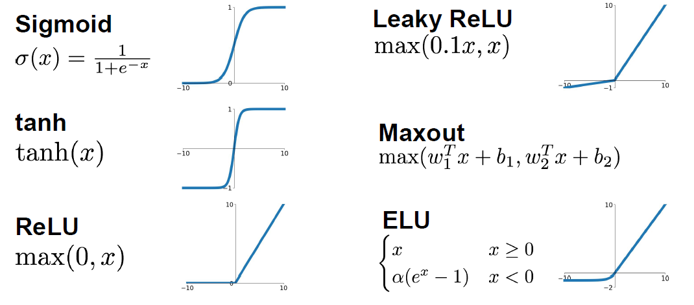
Neural networks
Activation functions
An activation function in a neural network defines how the weighted sum of the input is transformed into an output from a node or nodes in a layer of the network.
Output layer: Unlike all layers in a Neural Network, the output layer neurons most commonly do not have an activation

Slide 10
Neural networks
Setting up the data and the model
Additional design choices regarding data preprocessing, weight initialization need to be made
Data preprocessing:
Mean subtraction
Normalization
PCA and Whitening
Weight Initialization: Before we can begin to train the network, we must initialize its parameters.
All zero initialization
Small random numbers
Xavier initialization
He initialization
Batch Normalization.
Regularization : There are several ways of controlling the capacity of Neural Networks to prevent overfitting:
L2 regularization
L1 regularization
Max norm constraints
Dropout

Slide 11
Neural networks
Parameter updates
Once the analytic gradient is computed with backpropagation, the gradients are used to perform a parameter update. There are several approaches for performing the update:
SGD vanilla: change the parameters along the negative gradient direction. However it faces some problems with local minima or saddle point
SGD + Momentum
Nestrov momentum
AdaGrad
Adam
RMSProp
Notes:
https://dominikschmidt.xyz/nesterov-momentum/#:~:text=It%20is%20intuitively%20related%20to,gradient%20influences%20long%20term%20movement.
https://ruder.io/optimizing-gradient-descent/
https://machinelearningmastery.com/batch-normalization-for-training-of-deep-neural-networks/#:~:text=Batch%20normalization%20is%20a%20technique,layer%20for%20each%20mini%2Dbatch.&text=Batch%20normalization%20is%20a%20technique%20to%20standardize%20the%20inputs%20to,prior%20layer%20or%20inputs%20directly.

Slide 12
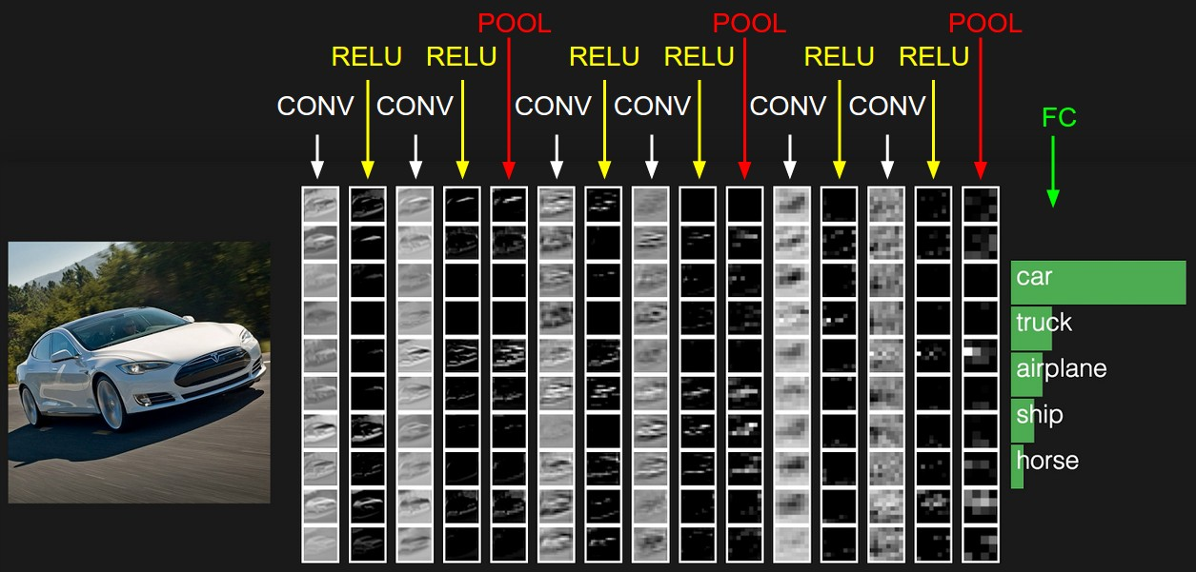
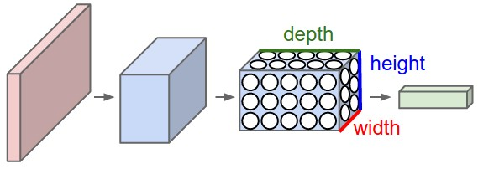
CNN
CNN assumes that the input is an image, and thus keeps the same structure of the input: i.e. 32x32x3.
Regular Neural Nets don’t scale well to full images.
We use three main types of layers to build ConvNet architectures: Convolutional Layer, Pooling Layer, and Fully-Connected Layer.
A ConvNet arranges its neurons in three dimensions (width, height, depth), as visualized in one of the layers. Every layer of a ConvNet transforms the 3D input volume to a 3D output volume of neuron activations
The activations of an example ConvNet architecture. The initial volume stores the raw image pixels (left) and the last volume stores the class scores (right).

Slide 13
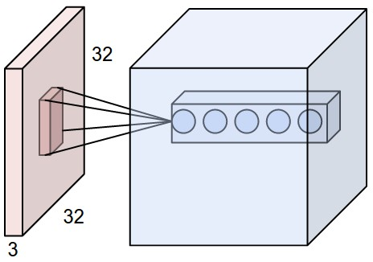
Convolutional Layer
Core building block of a Convolutional Network
The CONV layer’s parameters consist of a set of learnable filters. Every filter is small spatially (along width and height), but extends through the full depth of the input volume.
For example, a typical filter on a first layer of a ConvNet might have size 5x5x3 (i.e. 5 pixels width and height, and 3 because images have depth 3, the color channels).
During the forward pass, we slide (more precisely, convolve) each filter across the width and height of the input volume and compute dot products between the entries of the filter and the input at any position.
As we slide the filter over the width and height of the input volume we will produce a 2-dimensional activation map that gives the responses of that filter at every spatial position.
Now, we will have an entire set of filters in each CONV layer (e.g. 12 filters), and each of them will produce a separate 2-dimensional activation map. We will stack these activation maps along the depth dimension and produce the output volume.
An example input volume in red (e.g. a 32x32x3 CIFAR-10 image), and an example volume of neurons in the first Convolutional layer. Each neuron in the convolutional layer is connected only to a local region in the input volume spatially, but to the full depth (i.e. all color channels). Note, there are multiple neurons (5 in this example) along the depth, all looking at the same region in the input

Slide 14
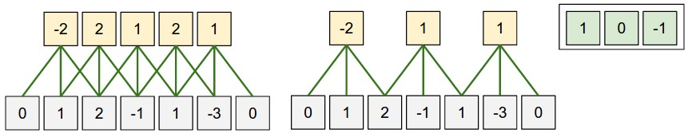
Convolutional Layer
Core building block of a Convolutional Network
Three hyperparameters control the size of the output volume: the depth, stride and zero-padding:
First, the depth of the output volume is a hyperparameter: it corresponds to the number of filters we would like to use, each learning to look for something different in the input.
Second, we must specify the stride with which we slide the filter. When the stride is 1 then we move the filters one pixel at a time.
Sometimes it is convenient to pad the input volume with zeros around the border. The size of this zero-padding is a hyperparameter. The nice feature of zero padding is that it will allow us to control the spatial size of the output volumes.
We can compute the spatial size of the output volume as a function of the input volume size (W), the receptive field size of the Conv Layer neurons (F), the stride with which they are applied (S), and the amount of zero padding used (P) on the border.
The formula for calculating how many neurons “fit” is given by (W−F+2P)/S+1.
Illustration of a spatial arrangement example. There is only one spatial dimension (x-axis), one neuron with a receptive field size of F = 3, the input size is W = 5, and there is zero padding of P = 1.
The neuron weights are in this example [1,0,-1] (shown on very right), and its bias is zero. These weights are shared across all yellow neurons.
Parameter Sharing: Parameter sharing scheme is used in Convolutional Layers to control the number of parameters. if one feature is useful to compute at some spatial position (x,y), then it should also be useful to compute at a different position (x2,y2).

Slide 15
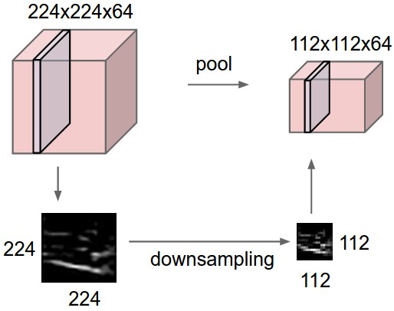
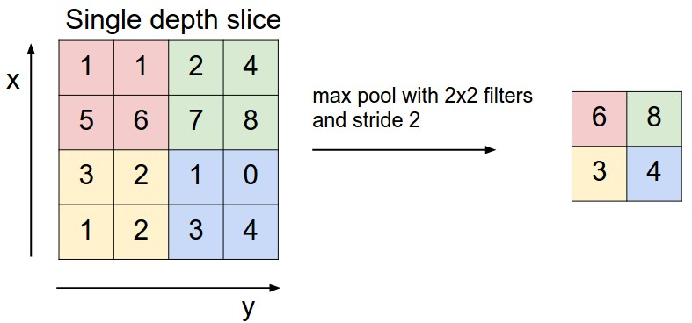
Pooling Layer
Core building block of a Convolutional Network
It is common to periodically insert a Pooling layer in-between successive Conv layers in a ConvNet architecture. Its function is to progressively reduce the spatial size of the representation to reduce the amount of parameters and computation in the network, and hence to also control overfitting. The Pooling Layer operates independently on every depth slice of the input and resizes it spatially, using the MAX operation.
Pooling layer downsamples the volume spatially, independently in each depth slice of the input volume.
Left: In this example, the input volume of size [224x224x64] is pooled with filter size 2, stride 2 into output volume of size [112x112x64]. Notice that the volume depth is preserved.
Right: The most common downsampling operation is max, giving rise to max pooling, here shown with a stride of 2. That is, each max is taken over 4 numbers (little 2x2 square).

Slide 16
Fully-connected layer
Core building block of a Convolutional Network
Neurons in a fully connected layer have full connections to all activations in the previous layer, as seen in regular Neural Networks. Their activations can hence be computed with a matrix multiplication followed by a bias offset. See the Neural Network section of the notes for more information.
It is worth noting that the only difference between FC and CONV layers is that the neurons in the CONV layer are connected only to a local region in the input, and that many of the neurons in a CONV volume share parameters. However, the neurons in both layers still compute dot products, so their functional form is identical.

Slide 17
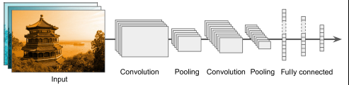
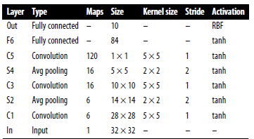
CNN Architectures
Various architectures are proposed throughout the literature
Typical CNN architectures stack a few convolutional layers (each one generally followed by a ReLU layer), then a pooling layer, then another few convolutional layers (+ReLU), then another pooling layer, and so on. The image gets smaller and smaller as it progresses through the network
Some of the most prominent CNN architectures:
LeNet-5 architecture (1998
AlexNet (2012)
GoogLeNet (2014)
ResNet (2015)
LeNet-5 architecture

Slide 18
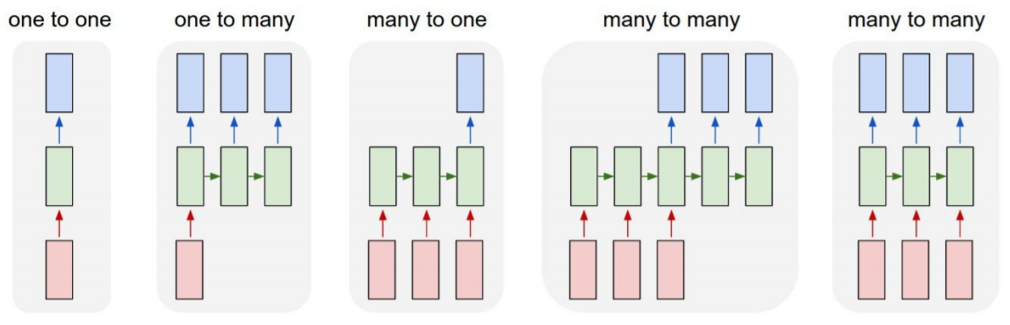
Recurrent Neural Networks
Type of neural networks capable of handling sequential data
A recurrent neural network looks very much like a feedforward neural network, except it also has connections pointing backward. You can easily create a layer of recurrent neurons. At each time step t, every neuron receives both the input vector x(t) and the output vector from the previous time step
Image Captioning image -> sequence of words
Sentiment Classification
sequence of words -> sentiment
Machine Translation
seq of words -> seq of words
Video classification on frame level

